Slide 1



SMART INDIA HACKATHON 2024
TITLE PAGE
Problem Statement ID - SIH1633
Problem Statement Title– Alumni Portal: Connecting Students with Alumni
Theme - Smart Education
PS Category- Software
Team ID - 0b53d8d1
Team Name (Registered on portal) - NEXIFY

Slide 2

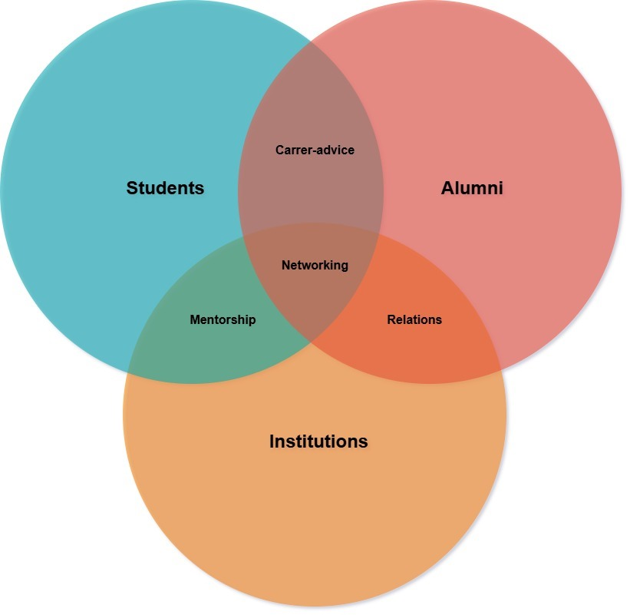
Alumni Connect
Why we are making what we are making
We are creating an intelligent platform to BRIDGE THE GAP between alumni and students, enhancing mentorship, networking, and career opportunities within the Technical Education Department of Rajasthan. Platform name is YUVA LINK
What we are making
We are developing an INTELLIGENT DIGITAL PLATFORM that connects alumni and current students of the Technical Education Department in Rajasthan, fostering MENTORSHIP, NETWORKING, AND CAREER GUIDANCE.
Key Features:
PERSONALIZED MENTORSHIP MATCHING
BETTER CONNECTIONS
CAREER GUIDANCE AND JOB REFERRALS
Innovation and Uniqueness:
INTELLIGENT MATCHING ALGORITHM
SCALABILITY AND ADAPTABILITY
ENHANCED ALUMNI INVOLVEMENT
REAL-TIME ENGAGEMENT
How It Addresses the Problem
Strengthens Community: Bridges the gap between ALUMNI AND STUDENTS, a supportive and interactive educational ecosystem

Slide 3
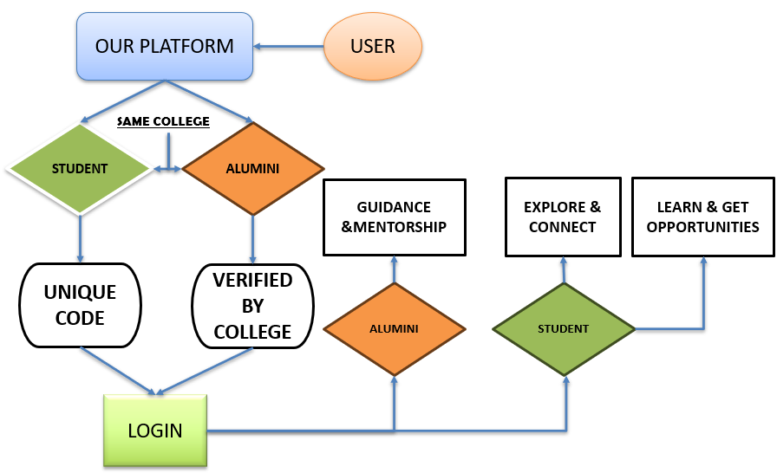
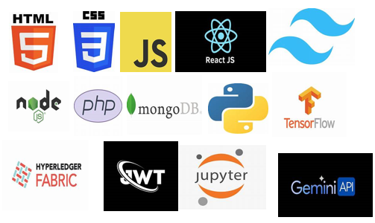
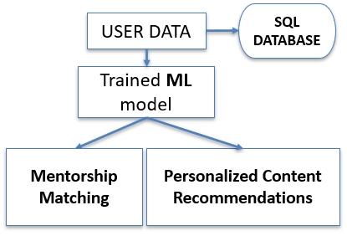
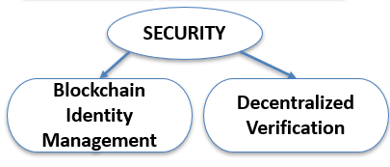

TECHNICAL APPROACH
METHODOLOGY AND PROCESS IMPLEMENTATION
TECH TO BE USED

Slide 4


FEASIBILITY AND VIABILITY
#Feasibility Analysis:
Technological Feasibility :The current technology stack, including blockchain, databases, and cloud services, can effectively support the development and scaling of YUVA LINK to connect alumni and students.
Market Feasibility: Demand and need for a platform like YUVA LINK that connects alumni and students, ensuring effective engagement and collaboration within the Technical Education Department of the Govt. of Rajasthan.
#Potential challenges:
Content Accuracy: Choosing Appropriate Algorithms for Accurate Training Data and Regular Validation.
User Adoption and Engagement :Convincing Alumni and Students to regularly use the platform, which might require significant marketing efforts and user-friendly design
#Strategies for overcoming Challenges:
Rigorous Testing and Iteration: Continuous feedback loops with educators and students.
Use of Advanced Technologies for Accessibility: .
Text-to-Speech and Speech-to-Text
Responsive and Adaptive Design

Slide 5


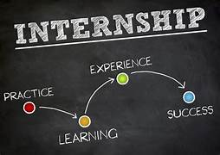


Impacts on Students and Potential Benefits
Networking Opportunities:
Students can connect with industry professionals, expanding their professional network and potential career opportunities
Mentorship and Guidance:
Access to experienced alumni mentors for valuable career advice, guidance and insights into the industry.
Job Placement and Internships:
Increased chances of securing job placements and internships through connections facilitated by the alumni portal.
Real-World Insights:
Benefit from practical advice and real-world experience shared by alumni, providing valuable perspectives on career paths.

Slide 6

DETAILS AND REFERENCES
Mentorship programs connecting alumni with students.
Virtual interaction spaces like forums and webinars.
Secure authentication using blockchain technology.
AI-powered content moderation.
Offers a personalized experience for users.
Comprehensive support through a unified platform.
Operationally viable with a clear implementation strategy.
Educational : Strengthens institutional support and outcomes.
ALMACONNECT (by Thapar) https://thapar.edu/academics/centerspages/almaconnect88?_ga=2.207379863.563382511.1725008227-2144133727.1695145168&_gl=1*1v7byql*_gcl_au*MTc0NDE1OTkwLjE3MjUwMDgyMjc\
HARRIS ALUMNI CONNECT https://www.youtube.com/watch?v=0ZHXUxJ19K0

